Slide 1
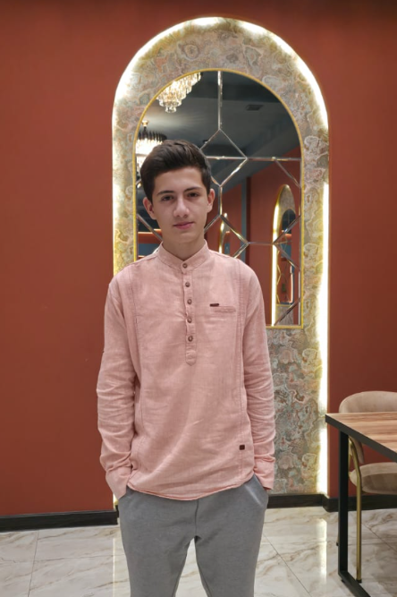
A U R O R A
THE FOUNDER
Ruslan
Novruzov
16 years old
Azerbaijan
AURORA begins with an ambition:
useful robotics for everyday life.
ASPIRING TECHNOLOGY ENTREPRENEUR
01 / 01
Notes:
Source: user production brief dated 2026-10-20. Current user-provided biography: Ruslan Novruzov, age 16, Azerbaijan.
All robot capabilities, engineering phases and safeguards are proposals. No physical prototype or validated performance is asserted. Illustrations are concept renders. Original portrait extracted unchanged from the user's previous PPTX.

Slide 2
A U R O R A
THE FOUNDER
An ambition taking shape
16
01
Robotics and AI
An interest in how intelligent systems interact with the physical world.
02
Entrepreneurship
An ambition to build a technology company around useful home assistance.
A starting point in Azerbaijan
01 / 02
Notes:
Source: user production brief dated 2026-10-20.
All robot capabilities, engineering phases and safeguards are proposals. No physical prototype or validated performance is asserted. Illustrations are concept renders. Original portrait extracted unchanged from the user's previous PPTX.

Slide 3
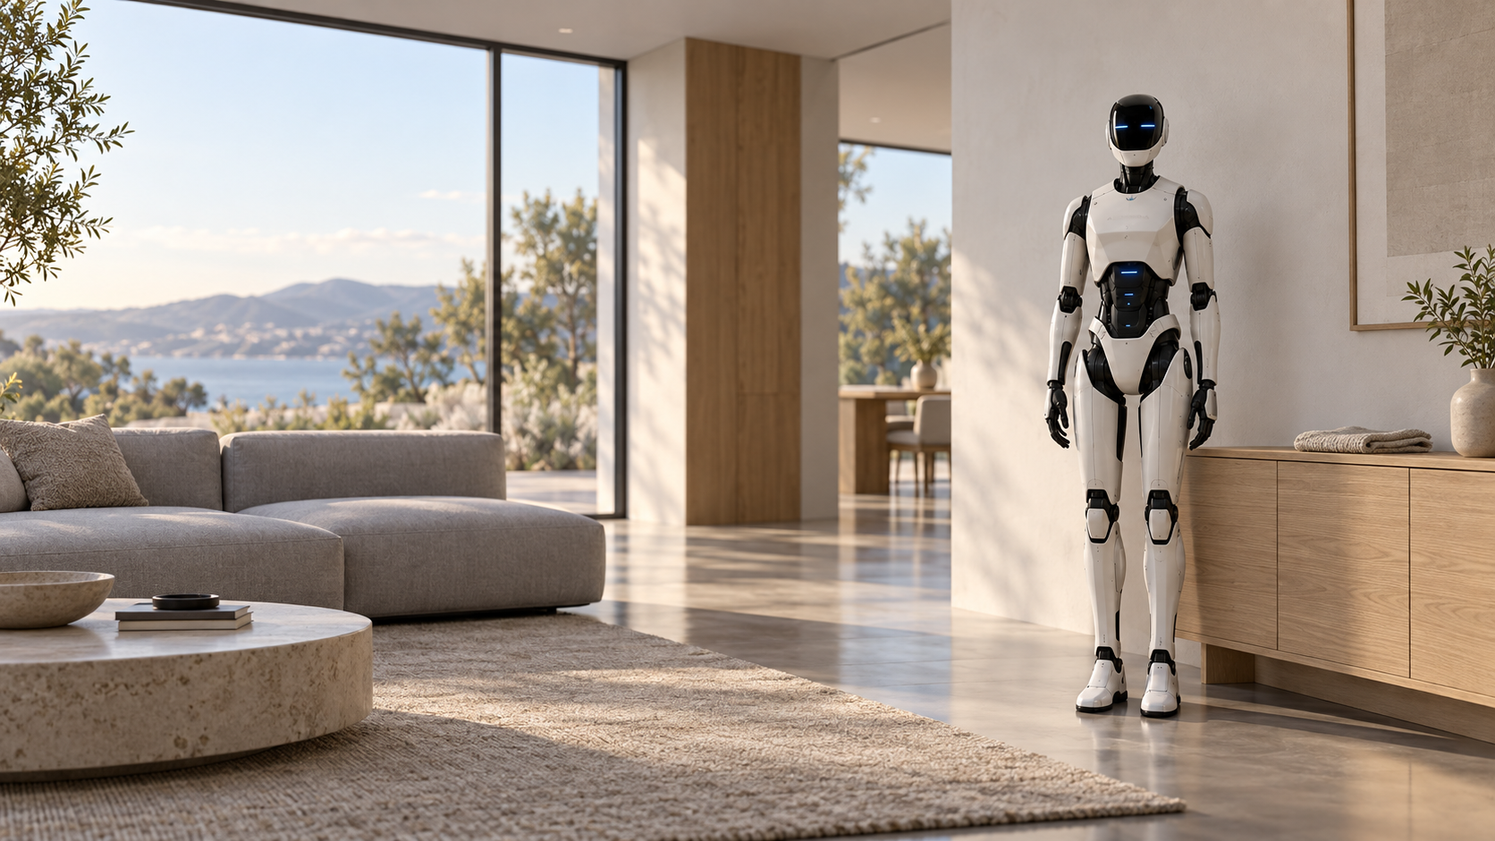
A U R O R A
THE FOUNDER
Why the
everyday
matters
Less routine work could
leave more time for people.
VISION FOR THE HOME / CONCEPT RENDERING
01 / 03
Notes:
Source: user production brief dated 2026-10-20.
All robot capabilities, engineering phases and safeguards are proposals. No physical prototype or validated performance is asserted. Illustrations are concept renders. Original portrait extracted unchanged from the user's previous PPTX.

Slide 4
A U R O R A
THE FOUNDER
A disciplined way to learn
01
02
03
Understand the home
Build understanding
Evaluate the result
Listen to users and identify a task worth solving.
Study robotics and seek feedback from experienced engineers.
Use evidence to revise assumptions and choose the next step.
INTENDED WORKING METHOD
01 / 04
Notes:
Source: user production brief dated 2026-10-20.
All robot capabilities, engineering phases and safeguards are proposals. No physical prototype or validated performance is asserted. Illustrations are concept renders. Original portrait extracted unchanged from the user's previous PPTX.

Slide 5
A U R O R A
THE FOUNDER
Collaboration shapes the venture
A founder’s role
Engineers
01
Challenge feasibility and the proposed safety architecture.
Define a clear purpose.
Invite expertise.
Keep progress honest.
02
Household users
Help define useful tasks and acceptable behavior.
Collaboration is a development principle. No existing team or partnerships are implied.
01 / 05
Notes:
Source: user production brief dated 2026-10-20.
All robot capabilities, engineering phases and safeguards are proposals. No physical prototype or validated performance is asserted. Illustrations are concept renders. Original portrait extracted unchanged from the user's previous PPTX.

Slide 6
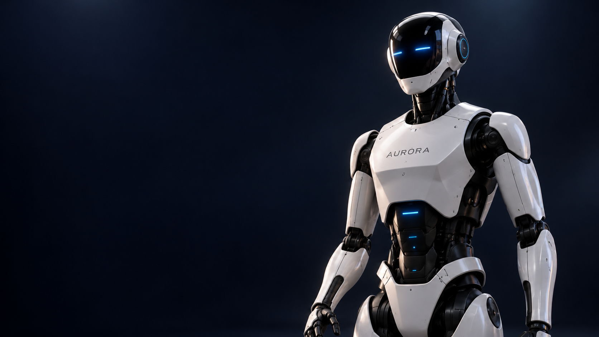
A U R O R A
THE FOUNDER
A long-term vision
for home robotics
Develop useful assistance through learning,
engineering and careful validation.
CONCEPT DEVELOPMENT / AI-GENERATED VISUAL
01 / 06
Notes:
Source: user production brief dated 2026-10-20. Founder ambition, not an achievement claim.
All robot capabilities, engineering phases and safeguards are proposals. No physical prototype or validated performance is asserted. Illustrations are concept renders. Original portrait extracted unchanged from the user's previous PPTX.

