Slide 1
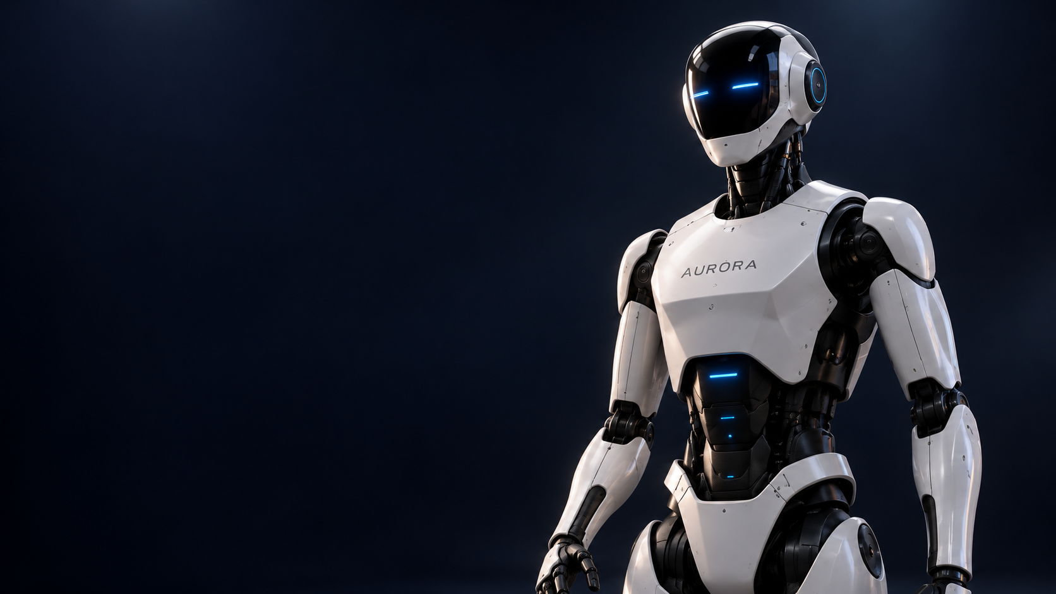
A U R O R A
THE ROBOT
AURORA
A humanoid concept for
everyday home assistance.
CONCEPT DEVELOPMENT / AI-GENERATED VISUAL
02 / 01
Notes:
Source: user production brief dated 2026-10-20.
All robot capabilities, engineering phases and safeguards are proposals. No physical prototype or validated performance is asserted. Illustrations are concept renders. Original portrait extracted unchanged from the user's previous PPTX.

Slide 2
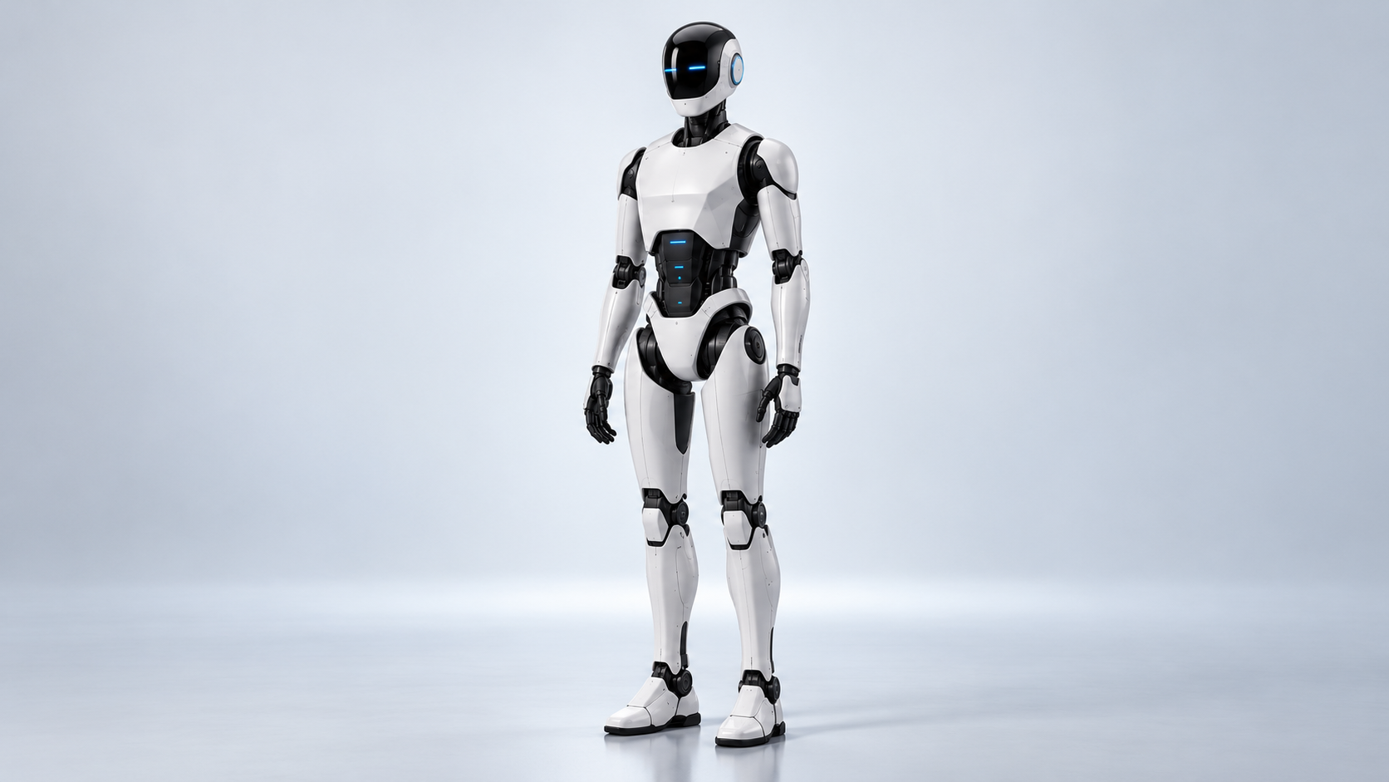
A U R O R A
THE ROBOT
Designed at
human scale
160–170
cm target height
White protective shell
Black mechanical joints
Dark visor with blue illumination
TARGET DIMENSION / CONCEPT RENDERING
02 / 02
Notes:
Source: user production brief dated 2026-10-20.
All robot capabilities, engineering phases and safeguards are proposals. No physical prototype or validated performance is asserted. Illustrations are concept renders. Original portrait extracted unchanged from the user's previous PPTX.

Slide 3
A U R O R A
THE ROBOT
A focused starting scope
Proposed household tasks, subject to engineering validation.
01
02
03
Cleaning support
Object collection
Basic assistance
Explore simple surface cleaning in a defined area.
Identify and move familiar objects within tested limits.
Respond to a clear request and report the outcome.
02 / 03
Notes:
Source: user production brief dated 2026-10-20.
All robot capabilities, engineering phases and safeguards are proposals. No physical prototype or validated performance is asserted. Illustrations are concept renders. Original portrait extracted unchanged from the user's previous PPTX.

Slide 4
A U R O R A
THE ROBOT
A request becomes a checked action
01
02
03
04
Voice
Perception
Planning
Control
Understand the
user’s request.
Locate relevant objects
and free space.
Choose a task within
the allowed scope.
Navigate and manipulate
within validated limits.
Human permission and an independent safety path must constrain every stage.
PROPOSED SYSTEM ARCHITECTURE
02 / 04
Notes:
Source: user production brief dated 2026-10-20.
All robot capabilities, engineering phases and safeguards are proposals. No physical prototype or validated performance is asserted. Illustrations are concept renders. Original portrait extracted unchanged from the user's previous PPTX.

Slide 5
A U R O R A
THE ROBOT
What must work together
01
Perception and navigation
Understand changing rooms, obstacles and uncertain sensor data.
02
Balance and manipulation
Coordinate stable motion with controlled, repeatable object handling.
03
Power and maintainability
Resolve energy demand, thermal limits and service access.
02 / 05
Notes:
Source: user production brief dated 2026-10-20.
All robot capabilities, engineering phases and safeguards are proposals. No physical prototype or validated performance is asserted. Illustrations are concept renders. Original portrait extracted unchanged from the user's previous PPTX.

Slide 6
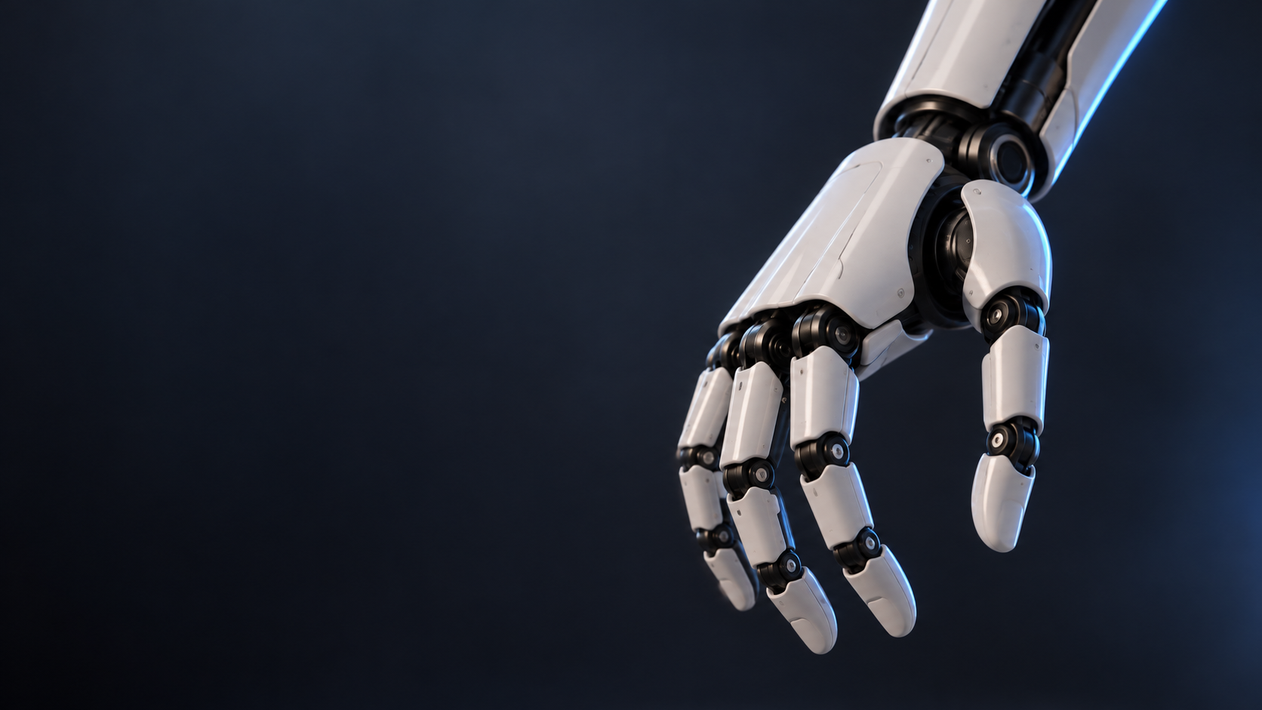
A U R O R A
THE ROBOT
More demanding
assistance comes later
Helping with heavier objects requires
validated balance, grip and force control.
No payload, runtime or autonomous
performance has been established.
FUTURE ENGINEERING OBJECTIVE / CONCEPT RENDERING
02 / 06
Notes:
Source: user production brief dated 2026-10-20.
All robot capabilities, engineering phases and safeguards are proposals. No physical prototype or validated performance is asserted. Illustrations are concept renders. Original portrait extracted unchanged from the user's previous PPTX.

