Slide 1
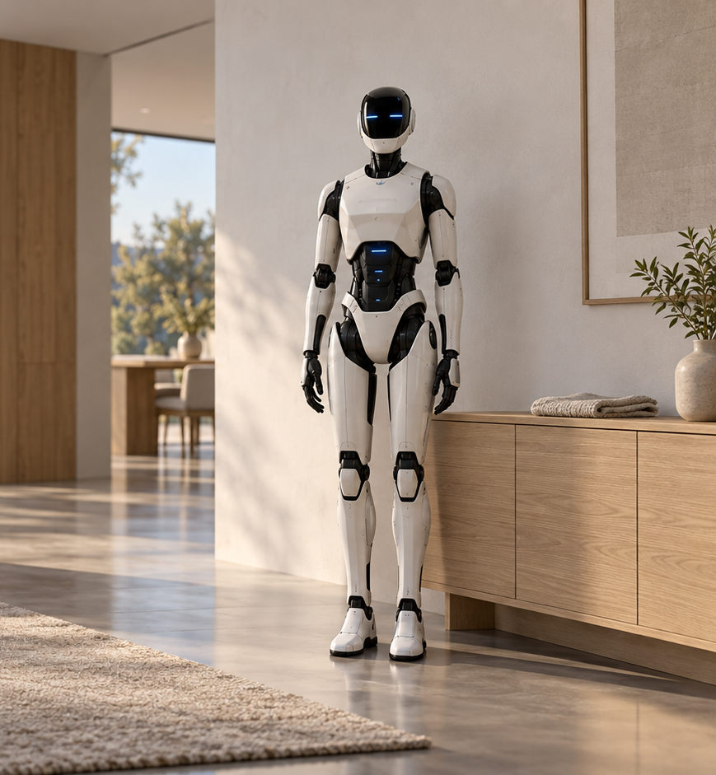
A U R O R A
MISSION AND PRINCIPLES
More time
for everyday life
AURORA explores how useful robotics
could reduce routine household work.
HOME ASSISTANCE VISION / CONCEPT RENDERING
04 / 01
Notes:
Source: user production brief dated 2026-10-20.
All robot capabilities, engineering phases and safeguards are proposals. No physical prototype or validated performance is asserted. Illustrations are concept renders. Original portrait extracted unchanged from the user's previous PPTX.

Slide 2
A U R O R A
MISSION AND PRINCIPLES
The purpose is practical
Time
Convenience
Routine tasks compete with
work, rest and family life.
Assistance should reduce effort
without creating a new burden.
The proposed value must be tested with household users.
04 / 02
Notes:
Source: user production brief dated 2026-10-20.
All robot capabilities, engineering phases and safeguards are proposals. No physical prototype or validated performance is asserted. Illustrations are concept renders. Original portrait extracted unchanged from the user's previous PPTX.

Slide 3
A U R O R A
MISSION AND PRINCIPLES
The user sets the purpose
You choose the task.
The system explains its limits.
Uncertainty prompts a question.
HUMAN-CENTERED ASSISTANCE
04 / 03
Notes:
Source: user production brief dated 2026-10-20.
All robot capabilities, engineering phases and safeguards are proposals. No physical prototype or validated performance is asserted. Illustrations are concept renders. Original portrait extracted unchanged from the user's previous PPTX.

Slide 4
A U R O R A
MISSION AND PRINCIPLES
Development principles
01
A narrow useful task
Define what completion means before adding complexity.
02
Evidence before expansion
Advance only when behavior is repeatable and reviewed.
03
Clear limits
Separate design intent, simulation and physical results.
04 / 04
Notes:
Source: user production brief dated 2026-10-20.
All robot capabilities, engineering phases and safeguards are proposals. No physical prototype or validated performance is asserted. Illustrations are concept renders. Original portrait extracted unchanged from the user's previous PPTX.

Slide 5
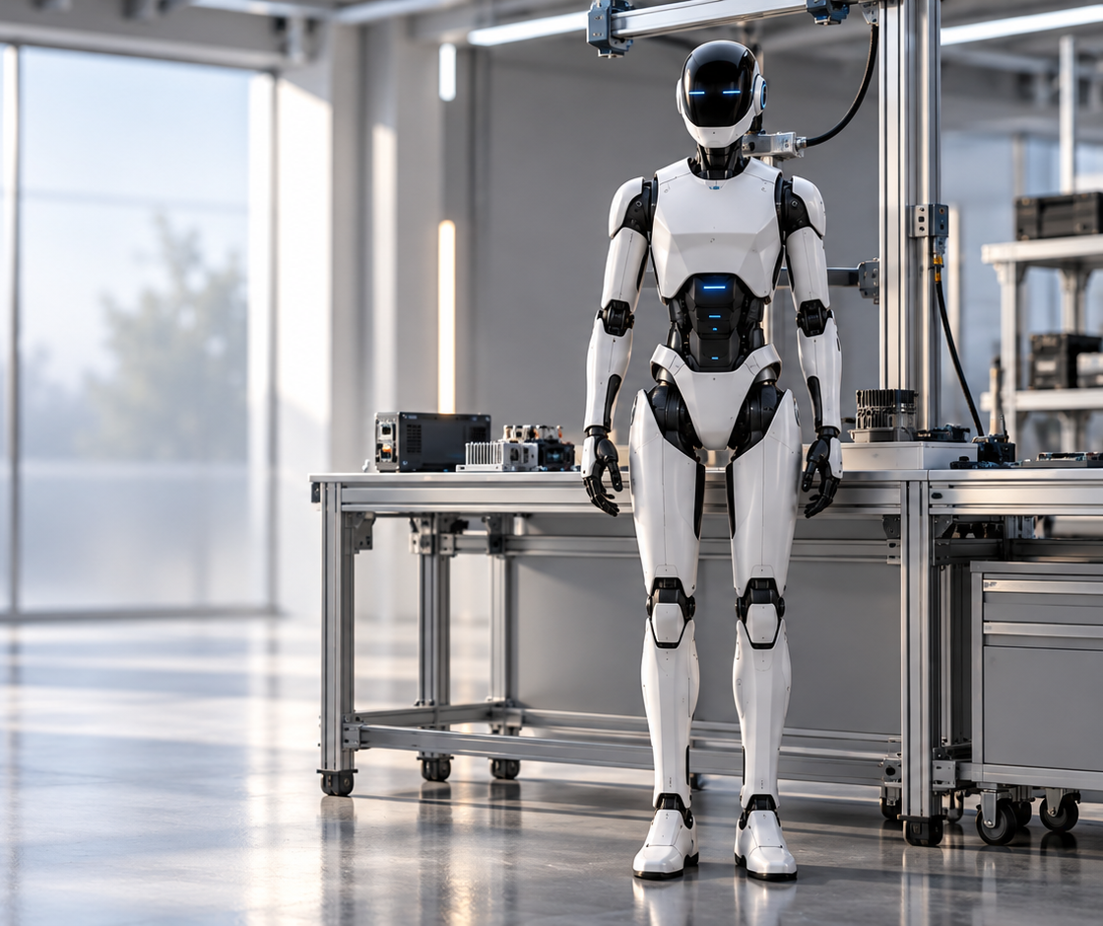
A U R O R A
MISSION AND PRINCIPLES
Open to expertise
Constructive challenge
Engineering feedback should
change weak assumptions.
Shared understanding
Document decisions, responsibilities
and the evidence behind them.
PROPOSED COLLABORATION / CONCEPT RENDERING
04 / 05
Notes:
Source: user production brief dated 2026-10-20.
All robot capabilities, engineering phases and safeguards are proposals. No physical prototype or validated performance is asserted. Illustrations are concept renders. Original portrait extracted unchanged from the user's previous PPTX.

Slide 6
A U R O R A
MISSION AND PRINCIPLES
Useful assistance.
Responsible progress.
Improve one validated capability at a time,
with people’s needs guiding the work.
LONG-TERM AMBITION
04 / 06
Notes:
Source: user production brief dated 2026-10-20.
All robot capabilities, engineering phases and safeguards are proposals. No physical prototype or validated performance is asserted. Illustrations are concept renders. Original portrait extracted unchanged from the user's previous PPTX.

