Slide 1
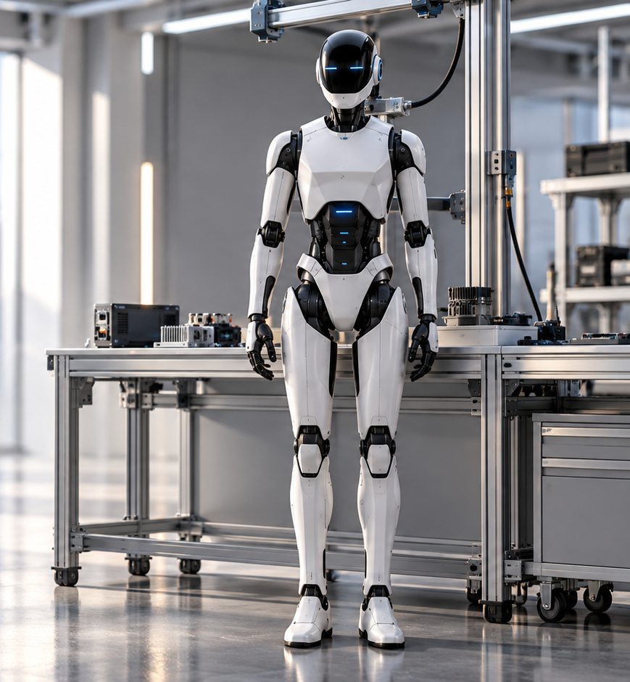
A U R O R A
The future
of AURORA
Progress depends on evidence.
No launch date is promised.
SEVEN PLANNED PHASES / CONCEPT RENDERING
05 / 01
Notes:
Source: user production brief dated 2026-10-20.
All robot capabilities, engineering phases and safeguards are proposals. No physical prototype or validated performance is asserted. Illustrations are concept renders. Original portrait extracted unchanged from the user's previous PPTX.

Slide 2
A U R O R A
FUTURE ROADMAP
Requirements before full system design
01
02
Research and requirements
Mechanical and electrical design
Choose household tasks.
Define operating limits.
Review risks and user needs.
Develop the architecture.
Study motion and power constraints.
Review engineering feasibility.
Review gate: agreed requirements and a credible engineering approach.
PLANNED PHASES 01–02
05 / 02
Notes:
Source: user production brief dated 2026-10-20.
All robot capabilities, engineering phases and safeguards are proposals. No physical prototype or validated performance is asserted. Illustrations are concept renders. Original portrait extracted unchanged from the user's previous PPTX.

Slide 3

A U R O R A
Component
prototypes
03
Test mechanisms, sensing and
interfaces separately before
assembling a full system.
Review gate: repeatable component
measurements under controlled conditions.
PLANNED PHASE 03 / CONCEPT RENDERING
05 / 03
Notes:
Source: user production brief dated 2026-10-20.
All robot capabilities, engineering phases and safeguards are proposals. No physical prototype or validated performance is asserted. Illustrations are concept renders. Original portrait extracted unchanged from the user's previous PPTX.

Slide 4
A U R O R A
FUTURE ROADMAP
Integration meets controlled testing
04
05
Software and AI integration
Controlled testing
Connect perception, task planning
and control. Keep the safety path
independent of high-level decisions.
Measure intended behavior.
Test obstacles, faults and recovery.
Record what remains uncertain.
Review gate: documented behavior and a completed safety review.
PLANNED PHASES 04–05
05 / 04
Notes:
Source: user production brief dated 2026-10-20.
All robot capabilities, engineering phases and safeguards are proposals. No physical prototype or validated performance is asserted. Illustrations are concept renders. Original portrait extracted unchanged from the user's previous PPTX.

Slide 5

A U R O R A
FUTURE ROADMAP
Limited household
assistance
06
Defined tasks.
Restricted environments.
Qualified oversight.
Review gate: measured reliability
and clear user instructions.
PLANNED PHASE 06 / CONCEPT RENDERING
05 / 05
Notes:
Source: user production brief dated 2026-10-20.
All robot capabilities, engineering phases and safeguards are proposals. No physical prototype or validated performance is asserted. Illustrations are concept renders. Original portrait extracted unchanged from the user's previous PPTX.

Slide 6
A U R O R A
FUTURE ROADMAP
Gradual capability
improvements
Observe
Refine
Validate
Review failures and user feedback.
Revise requirements and engineering.
Repeat tests before expanding scope.
Future work may explore heavier-object assistance after the required engineering validation.
PLANNED PHASE 07
05 / 06
Notes:
Source: user production brief dated 2026-10-20.
All robot capabilities, engineering phases and safeguards are proposals. No physical prototype or validated performance is asserted. Illustrations are concept renders. Original portrait extracted unchanged from the user's previous PPTX.

